Slide 1

USWDS Monthly Call
November 2023

Slide 2

Hi!
Thanks for being here!

Slide 3
Agenda
USWDS 3.7.0
Compile 1.1.0
New monthly call page
Usability research: Next steps
Q&A

Slide 4
Product updates

Slide 5
USWDS 3.7.0
Out now

Slide 6
Key improvements in USWDS 3.7.0
Improved JAWS keyboard navigation in Date picker
Improved keyboard navigation in Range slider
Added units data to Range slider
Allow custom language content in File input
Improved teardown of Modal in dynamic applications
Improved Banner initialization
Add an X social media icon

Slide 7
USWDS Compile 1.1.0
Out tomorrow

Slide 8
What’s new in USWDS Compile 1.1.0
Fixed a problem with sourcemaps paths
Added support for pnpm package manager

Slide 9
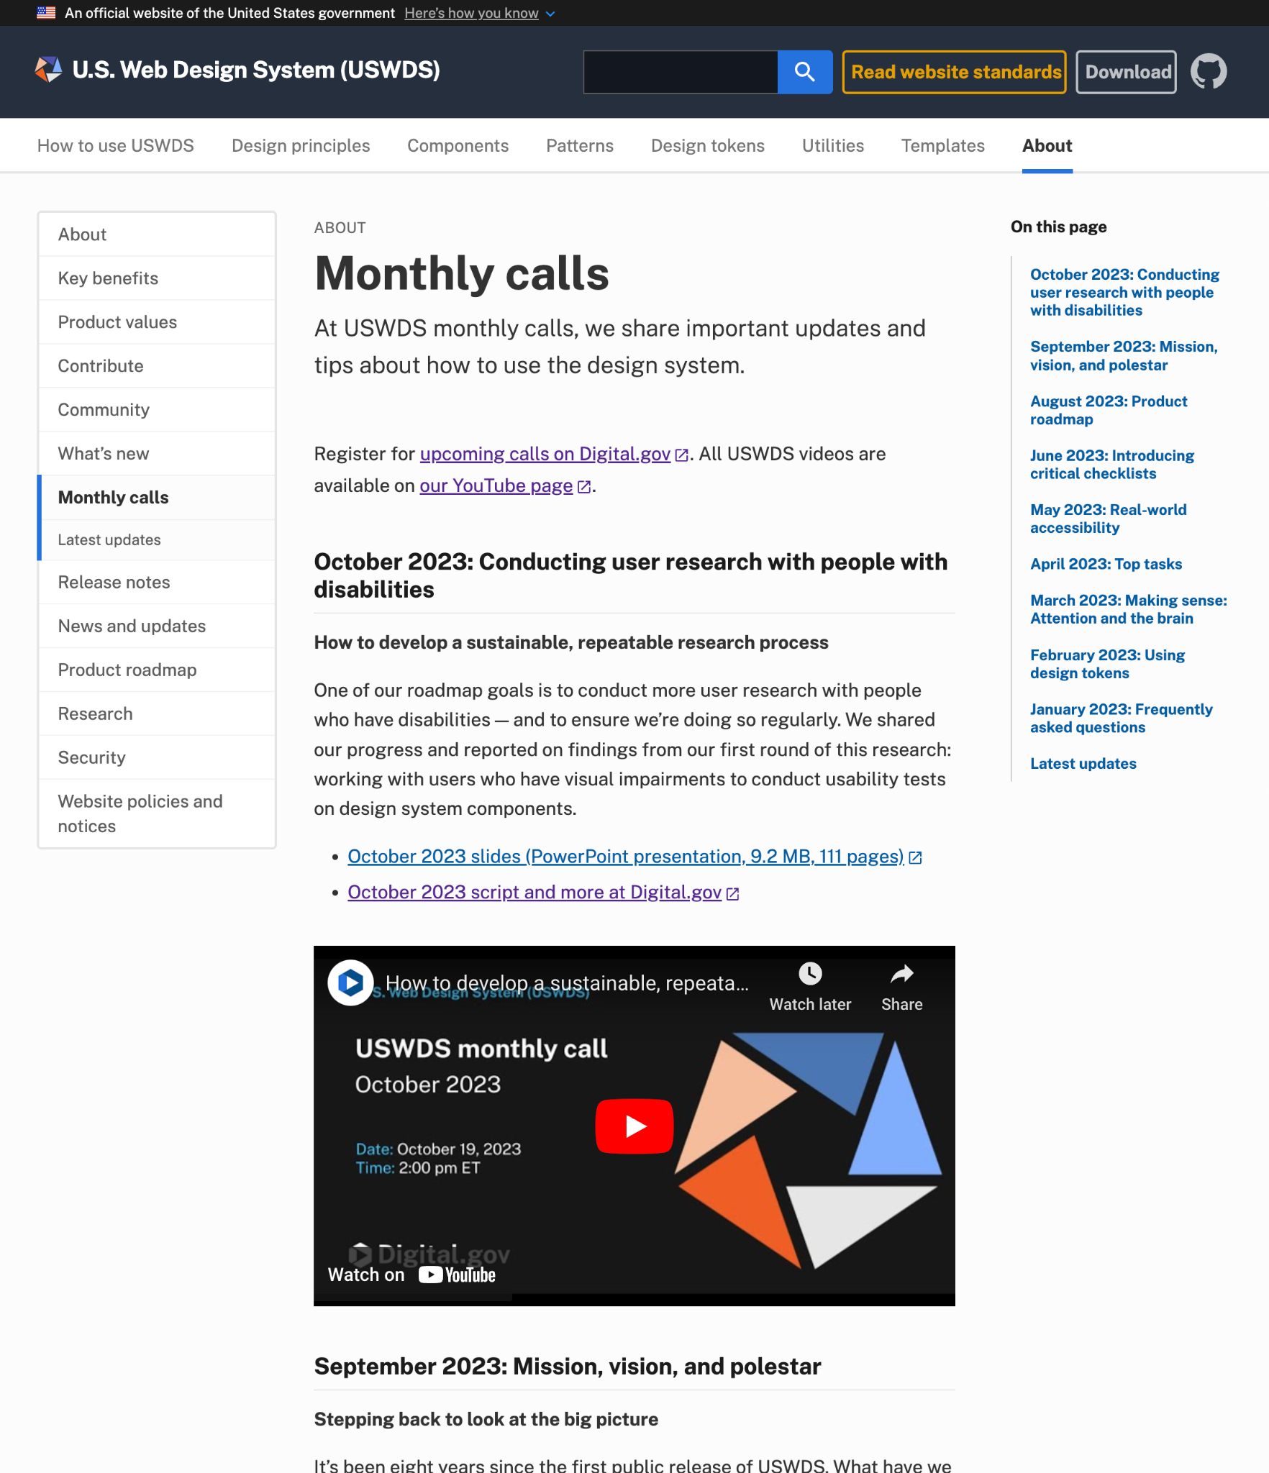
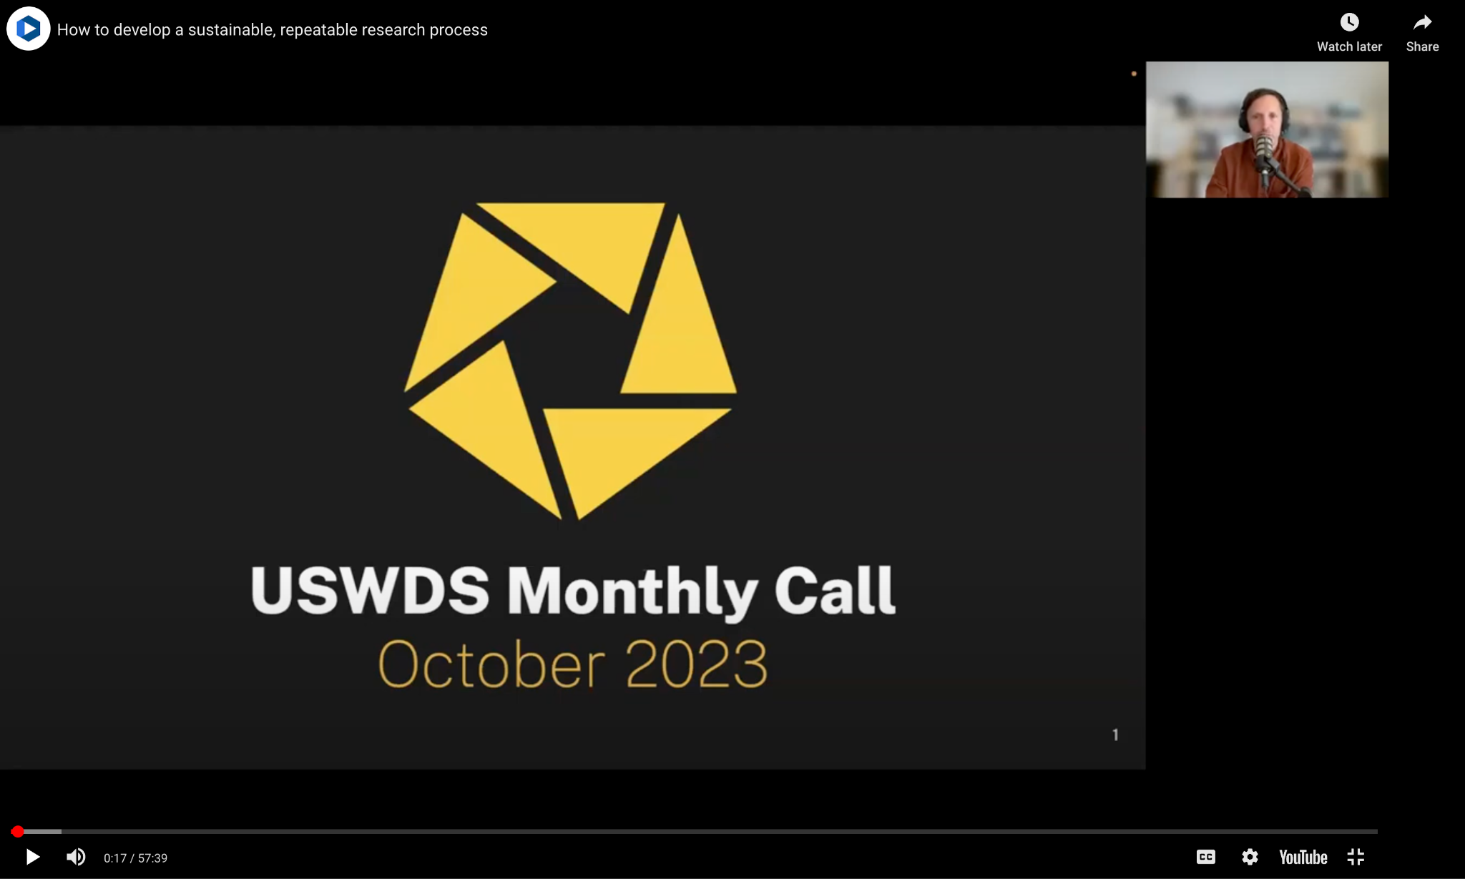
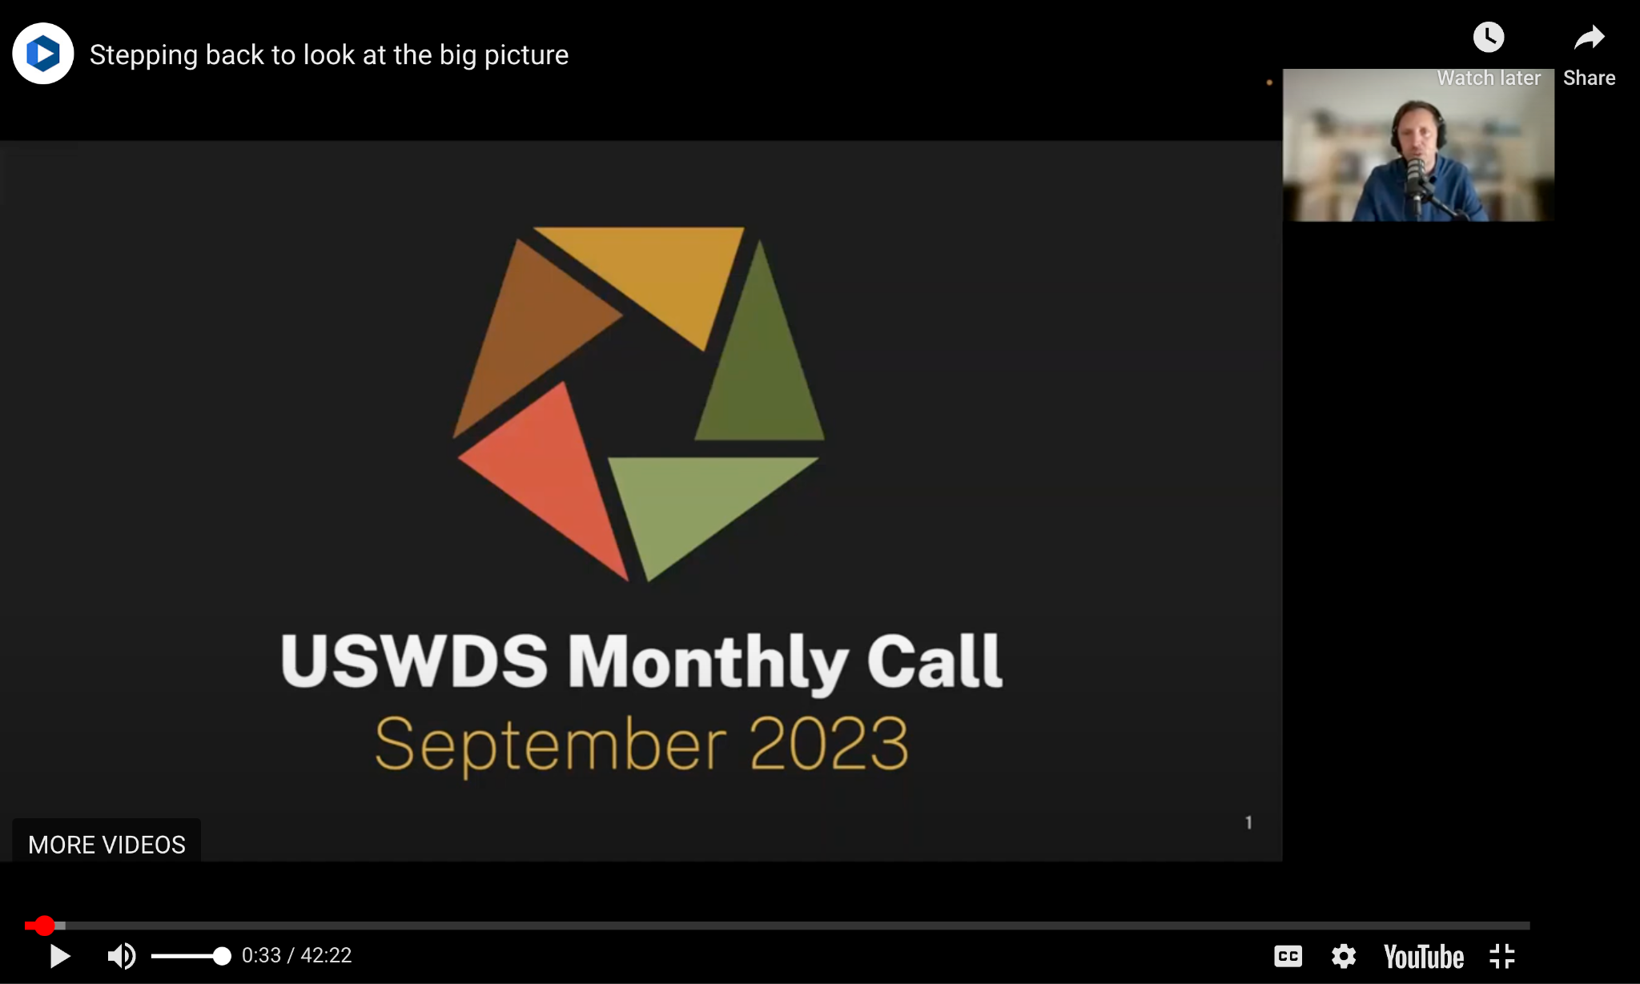
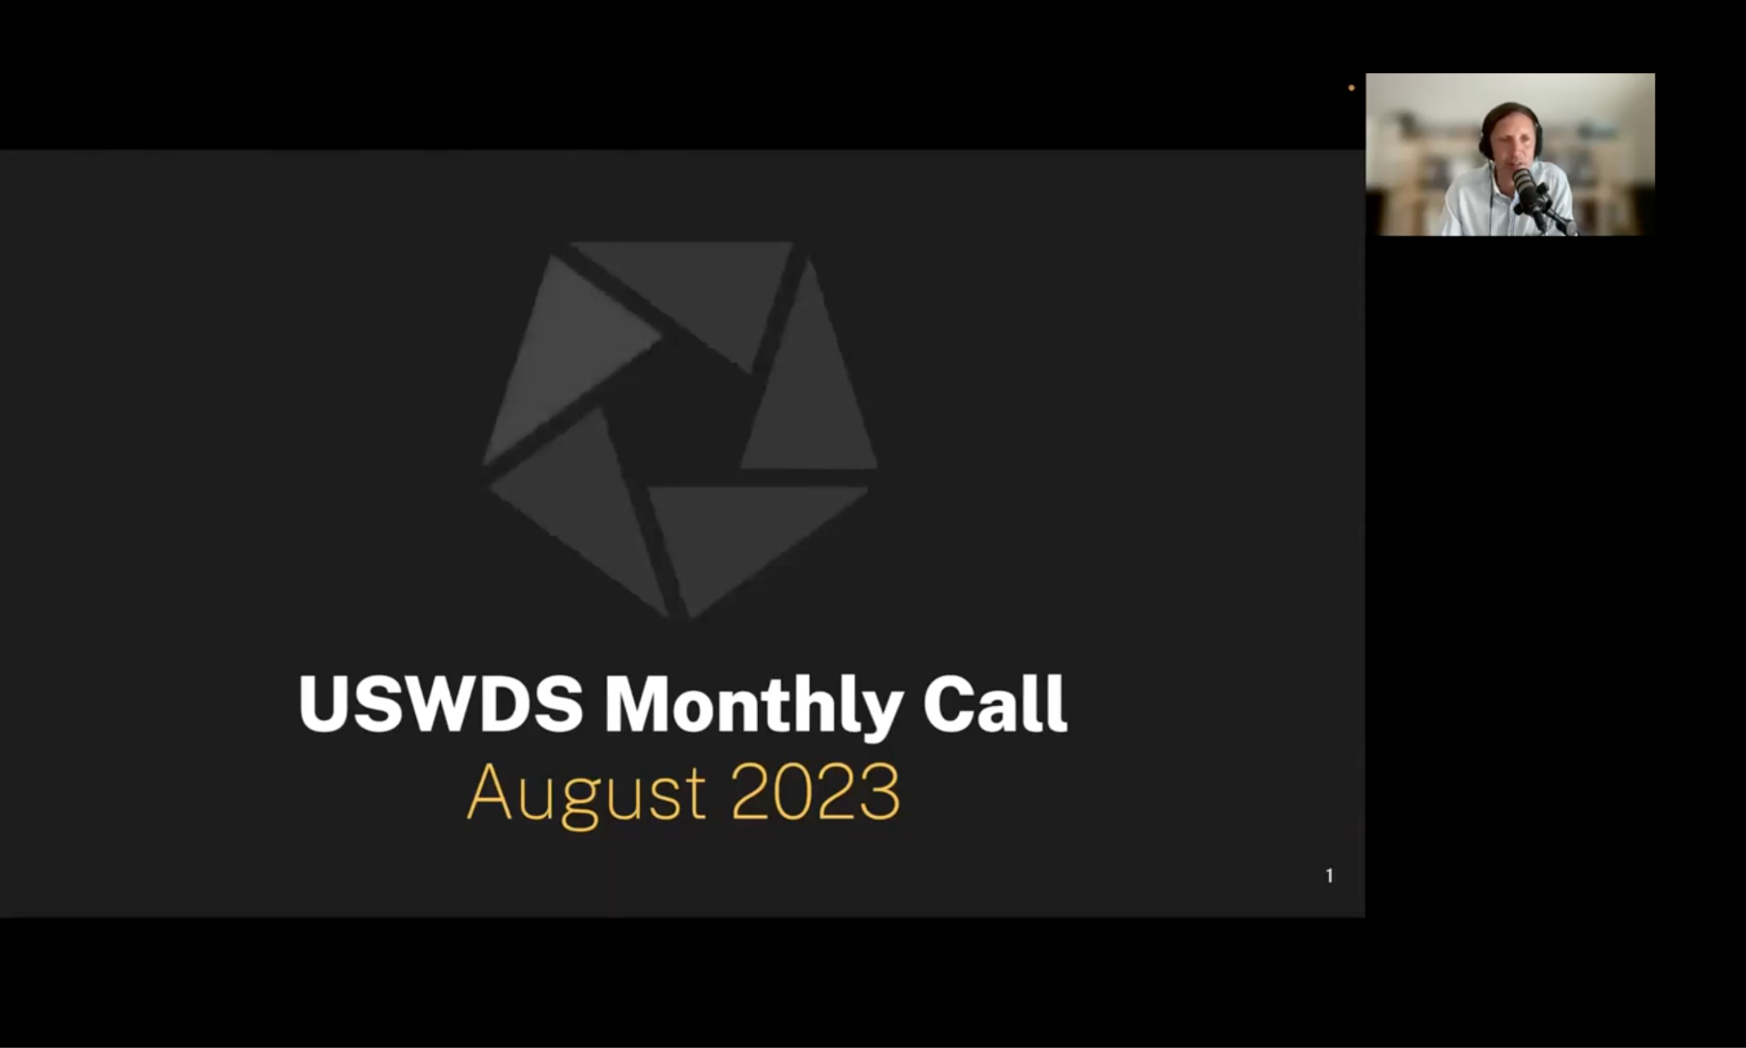
USWDS Monthly Calls
designsystem.digital.gov/about/monthly-calls

Slide 10
No monthly call in December

Slide 11
Usability research: Next steps
Applying what we learned

Slide 12
Research has been a challenge

Slide 13
Need to be more proactive

Slide 14
Got help with Research Ops

Slide 15
Testing with people with disabilities

Slide 16
What we tested
Accordion
Character count
Combo box
Date picker
File input
Input mask
Step indicator
Validation

Slide 17
Results
Accordion No friction
Character count Minor friction
Combo box Most friction
Date picker Most friction
File input Minor friction
Input mask Most friction
Step indicator No friction
Validation Most friction
Links styled as buttons Needs more research
Banner Needs more research

Slide 18
For more detail:
October 2023
designsystem.digital.gov/about/monthly-calls (!)

Slide 19
Jacline Contrino
she/her
UX Researcher, Contractor
USWDS

Slide 20
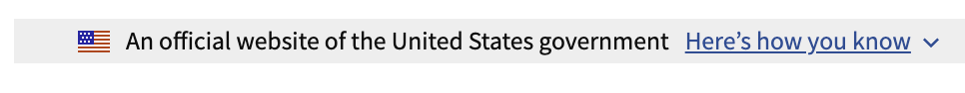
Banner
“
It can be confused for navigation.
“I was thinking [it] might be more menu options. Because usually any buttons that are collapsed at the top of the page like that are usually menu, navigation things.”
There can be button/link confusion.
A participant with some vision commented that it was an example of something labeled as a button that wasn’t a true button.
”

Slide 21
Forced colors and external plugins

Slide 22
Shared findings, discussed, and created GitHub issues

Slide 23
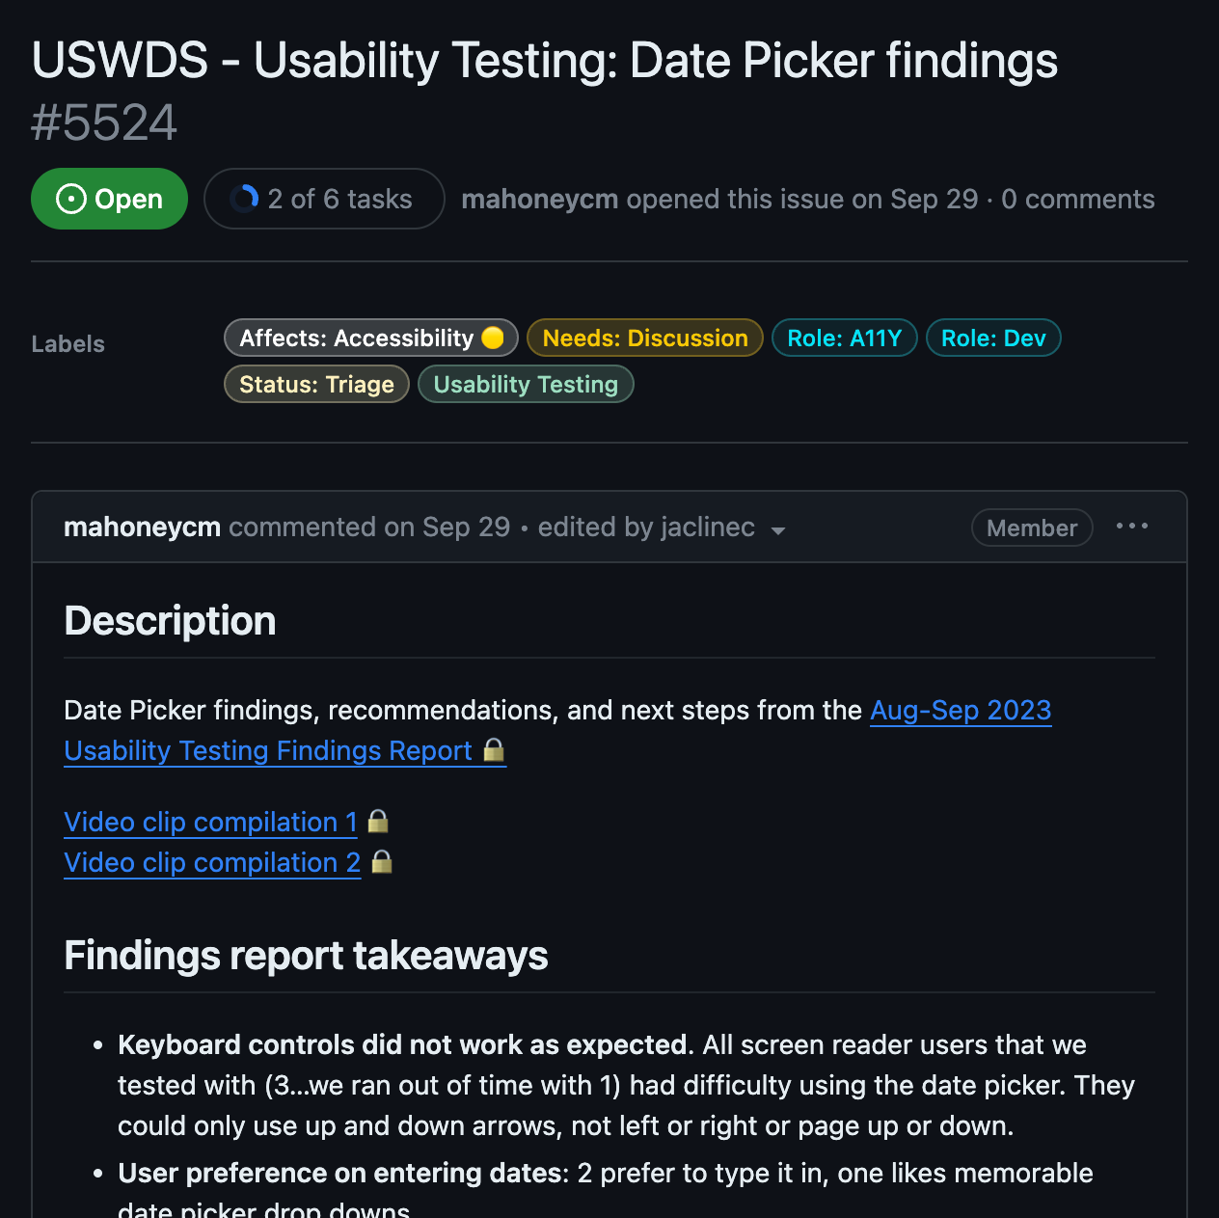
First, each component gets an issue…
Collecting findings in one place for discussion

Slide 24
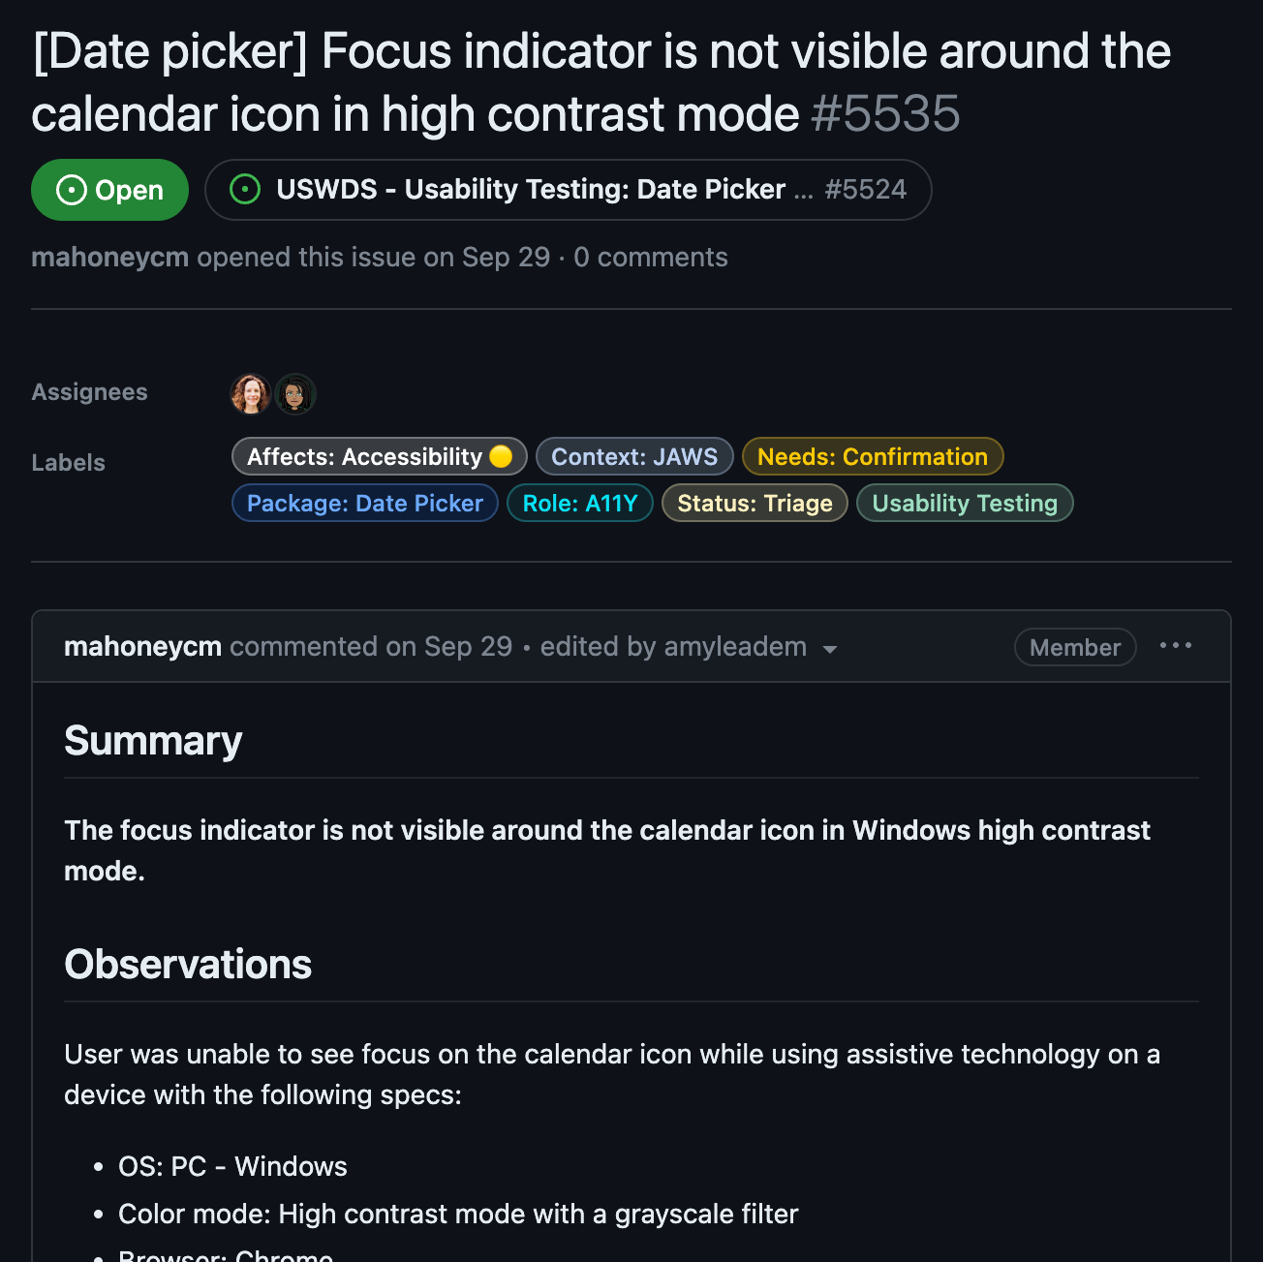
…then each finding gets an issue.
Tracking
individual findings

Slide 25
Lessons learned

Slide 26
Timing and scoping

Slide 27
Plan for more time
Especially for setup
Asking questions about full tech setup
Ensuring tech is working
Troubleshooting
Verbally obtaining informed consent
Study purpose, what to expect, voluntary participation

Slide 28
Scope: Scale it back

Slide 29
Make testing day run smoother with a checklist

Slide 30
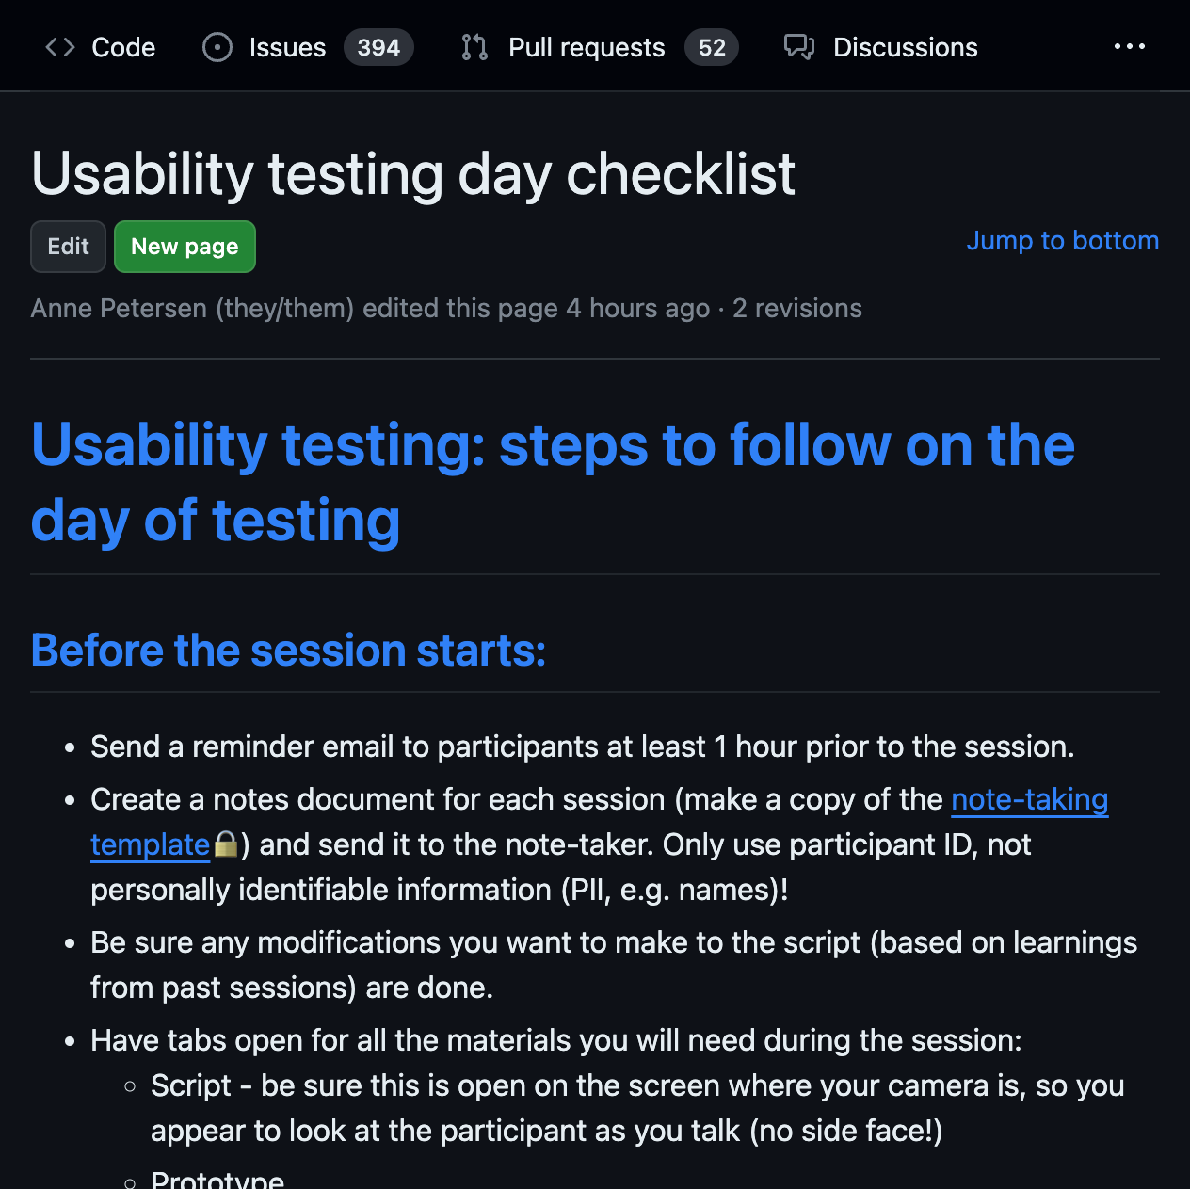
Our testing day checklist

Slide 31
Protecting participants

Slide 32
Personally identifiable information (PII)
Keep participants anonymous
Use testing platform settings (like turning off name display)
Allow participants to turn off camera or use an avatar

Slide 33
Be mindful of their screen sharing and what gets captured

Slide 34
Participation is voluntary. Really.

Slide 35
Test with a more realistic scenario

Slide 36
Best practices for testing with visually impaired participants

Slide 37
Do baseline manual accessibility testing first

Slide 38
Do a pilot. Work out any issues before the real thing

Slide 39
Honor participant preferences
Allow participants to use their own equipment.
Don’t ask participants to change their configurations.

Slide 40
Use accessible platforms and materials

Slide 41
Use high fidelity prototypes

Slide 42
Monitor energy levels and allow them to take breaks

Slide 43
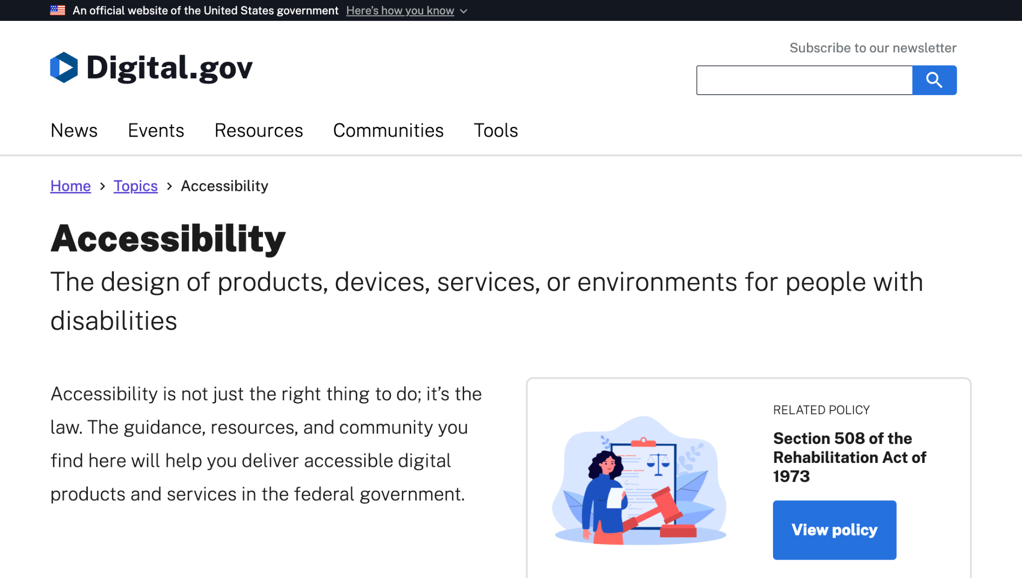
Check out Digital.gov’s accessibility guides and resources

Slide 44
Anne Petersen
they/them
Experience Design Lead
USWDS

Slide 45
What’s next?

Slide 46
Maturing our process

Slide 47
Our process is (part of) our product

Slide 48
The design system: Not just a commonality machine but a change machine

Slide 49
Our polestar
We help government teams align, design, and keep their websites and services up to date

Slide 50
What are we doing?

Slide 51
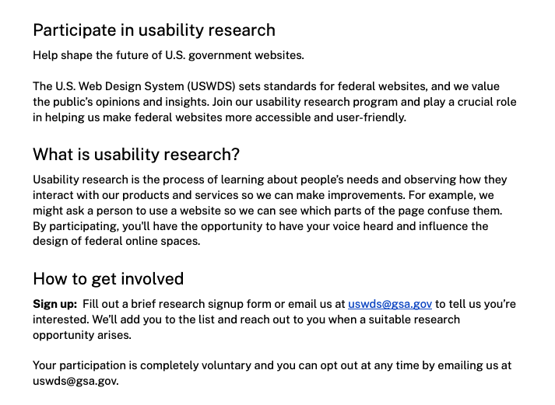
Future recruiting page
We’re drafting a new page for research participant recruitment

Slide 52
Regular research cadence

Slide 53
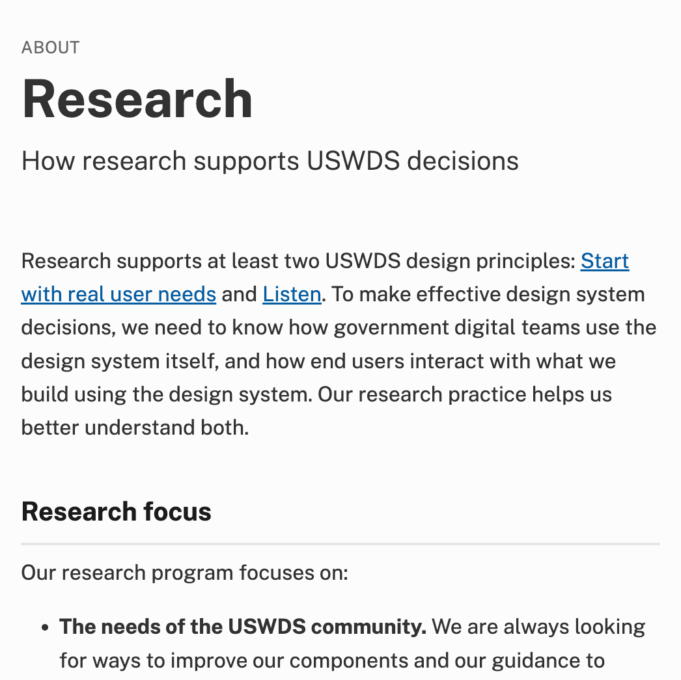
A new research page
First steps toward a better research resource

Slide 54
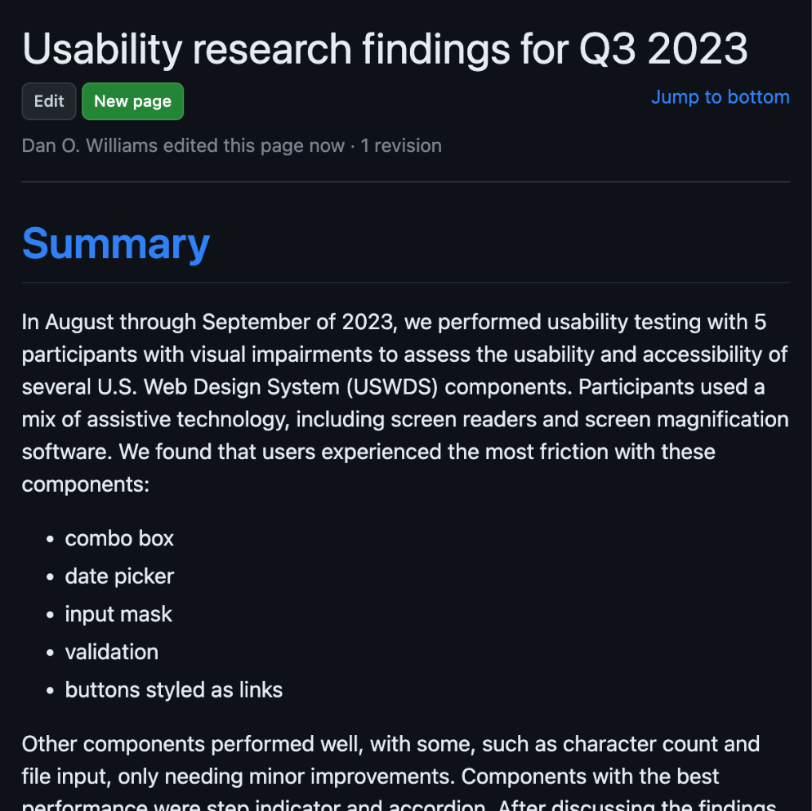
Usability
research findings
We’re publishing findings to our repository’s wiki, linked from relevant components

Slide 55
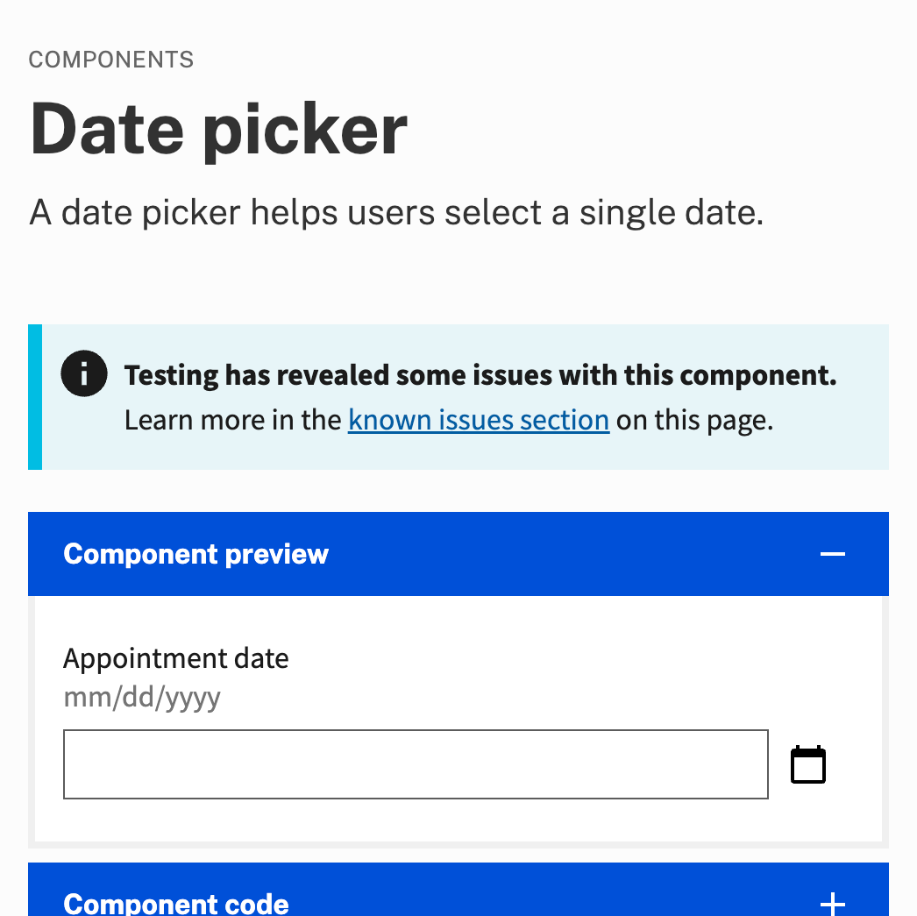
Component known issues
Each component with notable known issues will have an alert at the top of the page

Slide 56
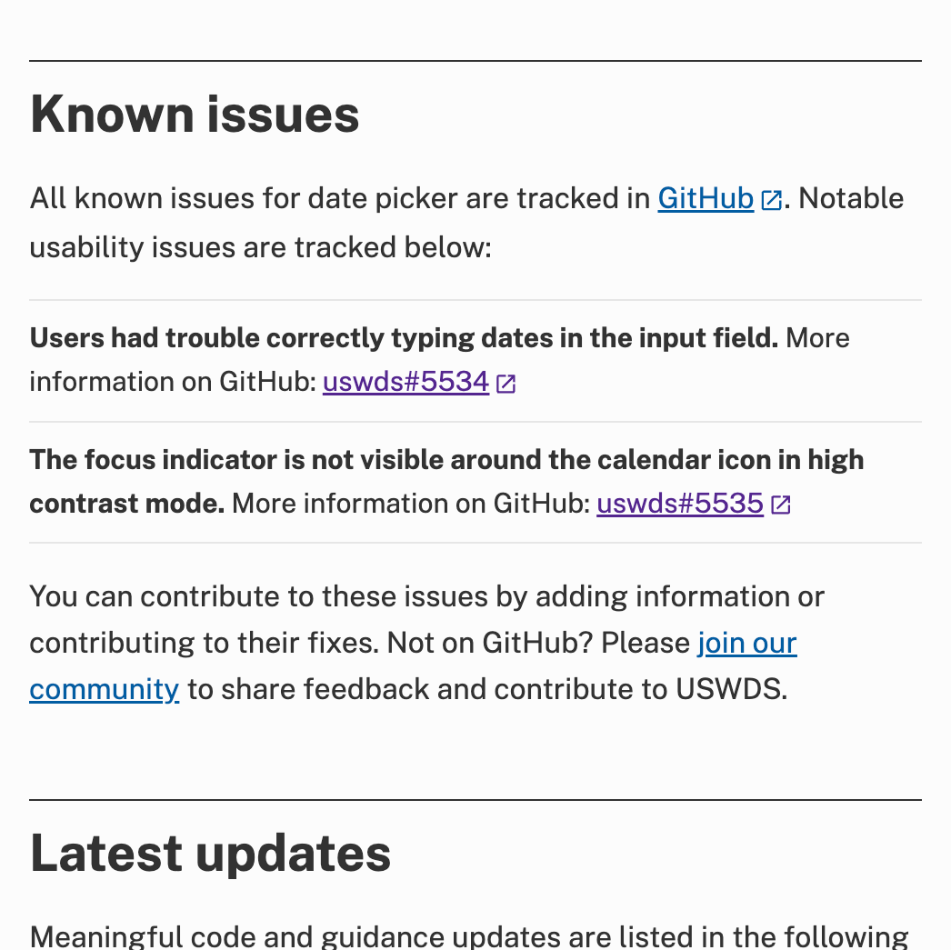
Component known issues details
We’ll collect notable known issues in a plain-language list, with a link to the issue in our code repository

Slide 57
Everyone should be able to make informed decisions

Slide 58
Planned for release

Slide 59
Establish ongoing accessibility-focused usability testing
Operationalize usability testing with people with disabilities as a sustainable, repeatable process that other teams could adapt
Why are we doing this?
To better understand how our components perform with real users, especially those with disabilities
To be proactive when it comes to component usability
To be able to share our process with other teams that want to improve their own usability testing capacity
Milestones
First: Develop a process for recruitment, management, compensation, and testing.
Next: Pilot this process and develop relationships with communities.
After: Perform ongoing testing and share our process with our own community.
Total: 6 months (2 months remaining)

Slide 60
Bit by bit.
Improvement by improvement.

Slide 61
Onward

Slide 62
Q&A

Slide 63
Next month
January: Launching critical checklists
#uswds-public
github.com/uswds
designsystem.digital.gov

